Slide 1

Mambu Training Manual
april 2022

Slide 2
I. Mambu Partner Academy

Slide 3
I. Mambu Partner Academy
Mambu Partner Academy Overview
Mambu Partner Academy, is the official Mambu accreditation program to ensure we have the skills to successfully:
01
Mambu Orientation
01
Prerequisite to all modules. A foundational understanding of Mambu.
Solutions Consultant
Accreditation
Mambu Orientation
Sales Accreditation
02
How to sell Mambu. Includes solution-based sales.
Solutions Consultant Accreditation
03
03
How to have a technical architecture discussion with a customer.
02
Sales Accreditation

Slide 4
I. Mambu Partner Academy
Mambu Partner Academy Overview
The accreditations enabling the user to understand Mambu, as well as being able to pitch Mambu to a customer.
Mambu orientation
Sales Accreditation
Solutions Consultant Accreditation
01
02
03
Prerequisits to all tracks. A foundational understanding of Mambu.
Includes:
Mambu Essentials for Partners;
Basic Terminology;
Introduction to Mambu Infrastructure and Deployment;
Introduction to Mambu Marketplace;
Introduction to the Mambu Process Orchestrator.
Note: Learning Path: 105 minutes (1h 45)
How to sell Mambu. Includes solution-based sales.
Includes:
What are the Market Trends and How Does the Mambu’s Value Proposition Fit?
What is Composability?
Overview of Mambu’s Functionality
How to have a techinical architecture discussion with a customer.
Includes:
Introduction to the Mambu User Interface;
Introduction to the Mambu Application Architecture;
Overview of Mambu’s Reference Architecture;
Overview of Mambu’s Reference Architectures;
Business User Introduction to Lending & Deposits;
System Administrator Configuration;
Deposits – Product Owner & Customer Account Associate Training;
Lending – product Owner & Customer Account Associate Training.
Note: The learning paths must be performed in the order presented.

Slide 5
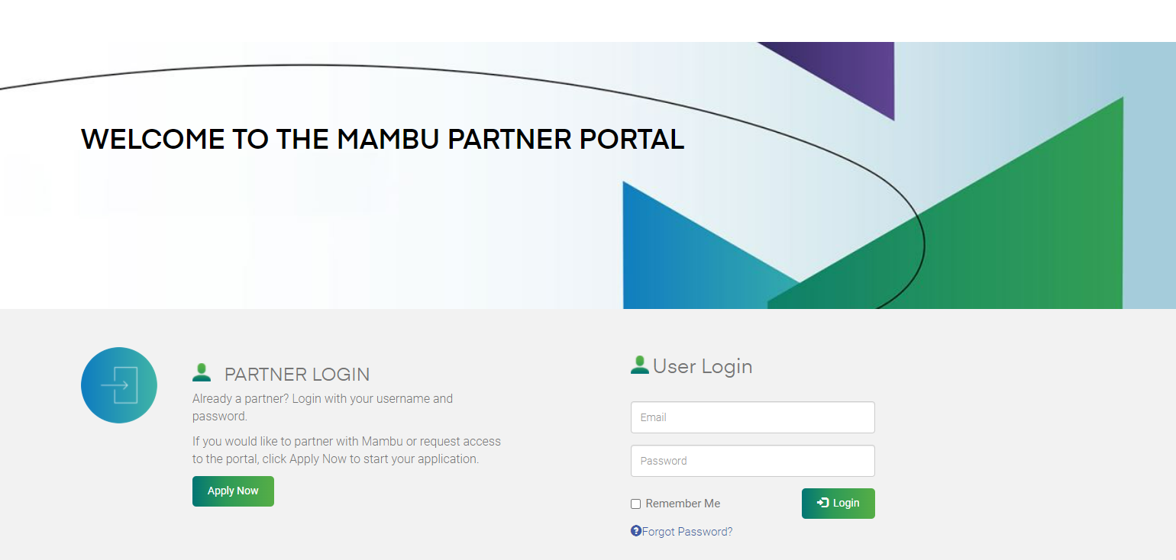
I. Mambu Partner Academy
Mambu Partner Academy: Register
1. Access the portal through the following link: Mambu Partner Program
Click Apply Now, to make a new registration

Slide 6
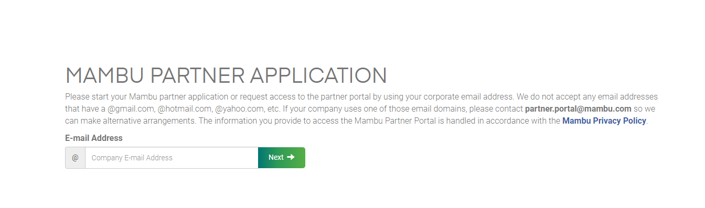
I. Mambu Partner Academy
Mambu Partner Academy: Register
2. By clicking Apply Now, you will be redirected to another page, where you need to enter your business email. After entering the email, click Next.
Insert your company e-mail address

Slide 7
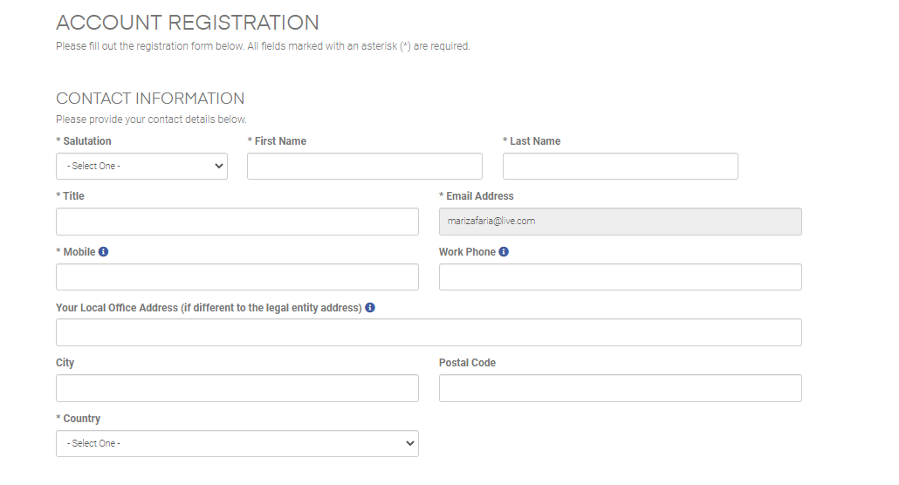
I. Mambu Partner Academy
Mambu Partner Academy: Register
3. By clicking Apply Now, you will be redirected to another page to Account Registration. Account Registration consists of filling in 3 sections: Contact Information, Company Information and Preferences.
Area of Contact Information:
Area of Contact Information

Slide 8
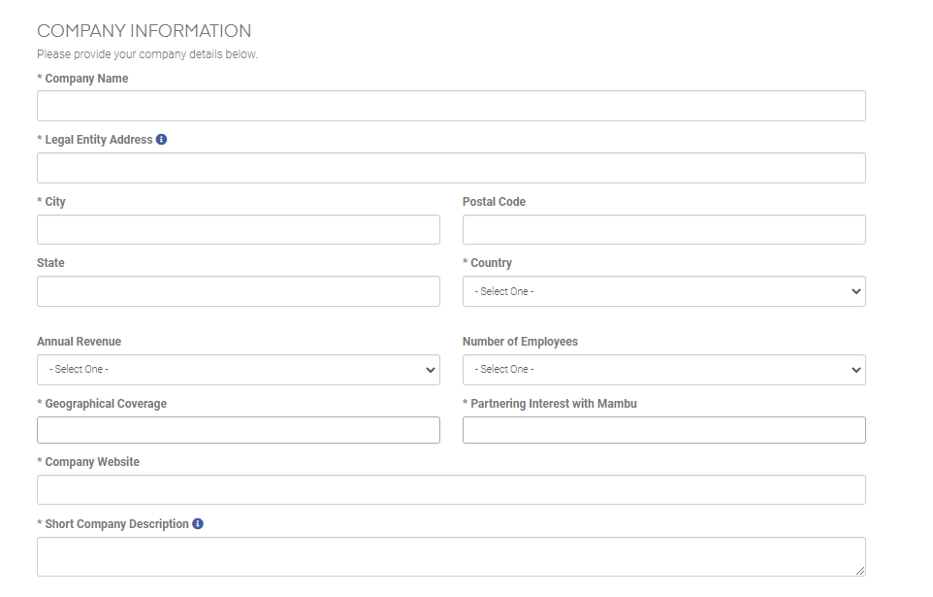
I. Mambu Partner Academy
Mambu Partner Academy: Register
4. Area of Company Information:
Area of Company Information

Slide 9
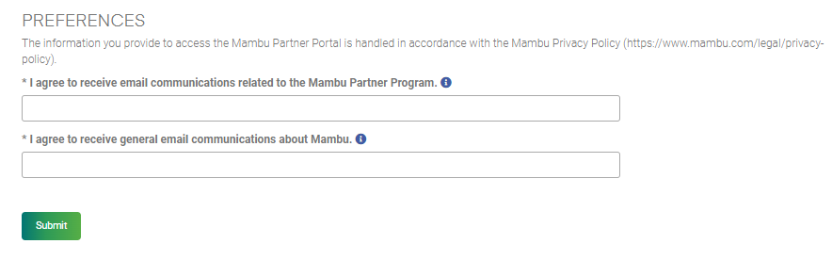
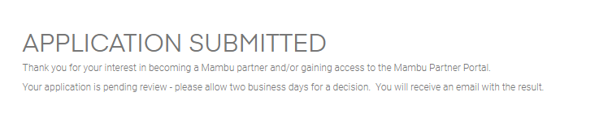
I. Mambu Partner Academy
Mambu Partner Academy: Register
5. Area of Area of Preferences. After completing all sections, click the Submit button. After submitting the form, appear a confirmation message Application Submitted. In a few minutes, you will receive a validation email in your company mailbox.
Area of Preferences
Click Submit, to Register
Confirmation message

Slide 10
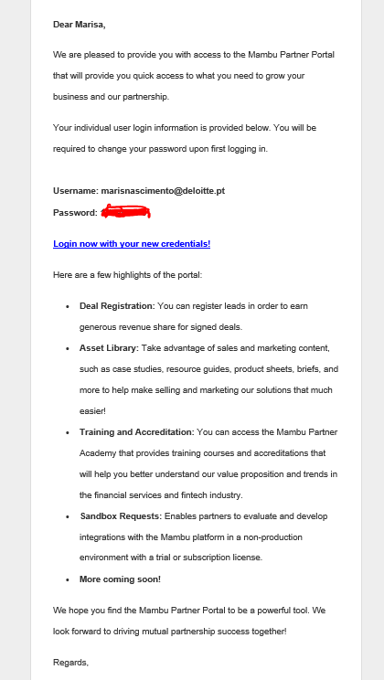
I. Mambu Partner Academy
Mambu Partner Academy: Register
6. In your company mailbox, you will receive the Username and Password to enter the portal. Click on the link to access the Mambu Partner Portal.
Note: Username and password must not be shared.
Username and Password to acess the Portal Mambu Partner Academy
Click on the link to access the Mambu Partner Portal

Slide 11
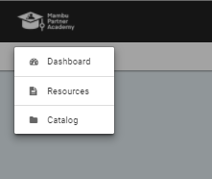
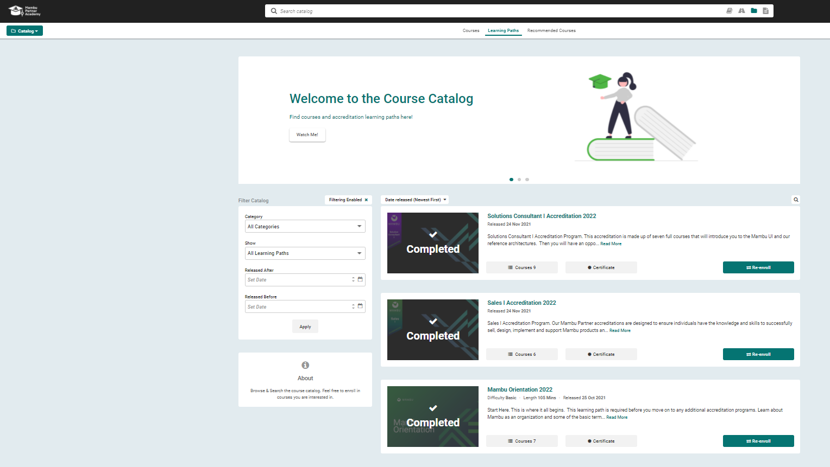
I. Mambu Partner Academy
Mambu Partner Academy: Learning Paths
7. In the displayed menu, in the upper left corner of the page, you must click the Catalog option. After, click Learning Paths.
2. Click: Learning Paths
1. Click: Catalog

Slide 12
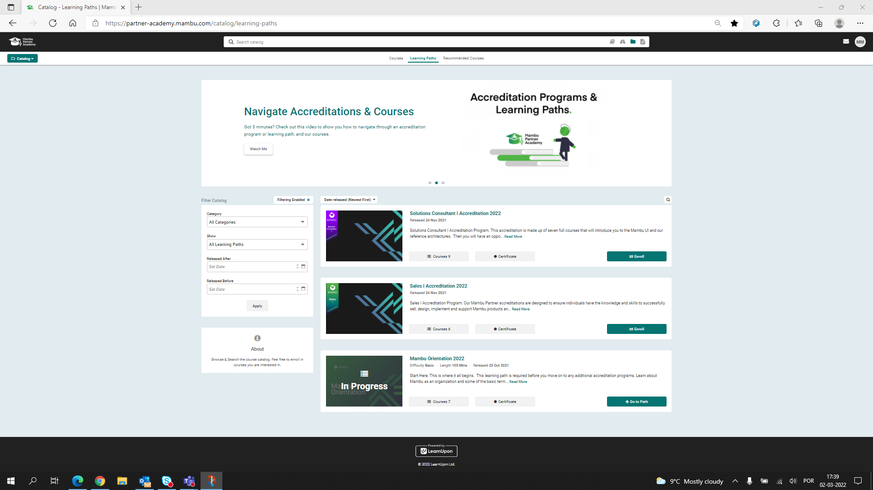
I. Mambu Partner Academy
Mambu Partner Academy: Learning Paths
8. In the Learning paths, you will find the 3 modules that make up the Mambu training. You should start with training in Mambu Orientation, Sales Accreditation and Solutions Consultant. To do so, click the Enroll button.
More information: click here
Learning Paths
Click: Enroll

Slide 13
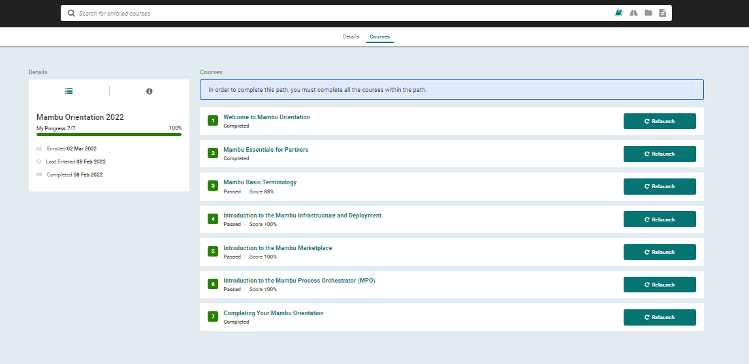
I. Mambu Partner Academy
Mambu Partner Academy: Learning Paths – Mambu Orientation 2022
9. When to click the first learning path: Mambu Orientation 2022, an overview of the course is presented. By clicking the Courses tab, all the courses that make up the selected learn path are displayed.
Click the first course: Welcome to Mambu Orientation.
Click de tab “Courses”
1st course – Welcome to Mambu Orientation
Details of the Learning path
Courses that make up the learning path.
The courses must be attended in the order presented.

Slide 14
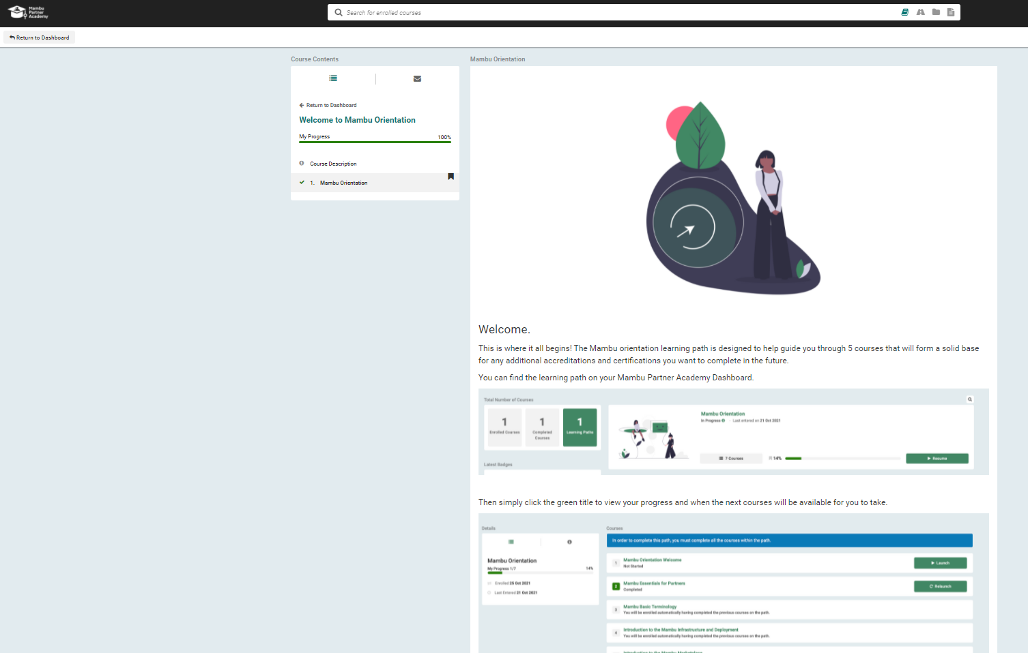
I. Mambu Partner Academy
Mambu Partner Academy: Learning Paths – Mambu Orientation 2022
10. When to click the first course Welcome to Mambu Orientation is presented all lessons make up the theme selected. After read all information, in the upper left corner click the option Return to dashboard.
Click: Return to dashboard
Note:
After read, all information about lesson, the bar of progress is full.
Lesson content

Slide 15
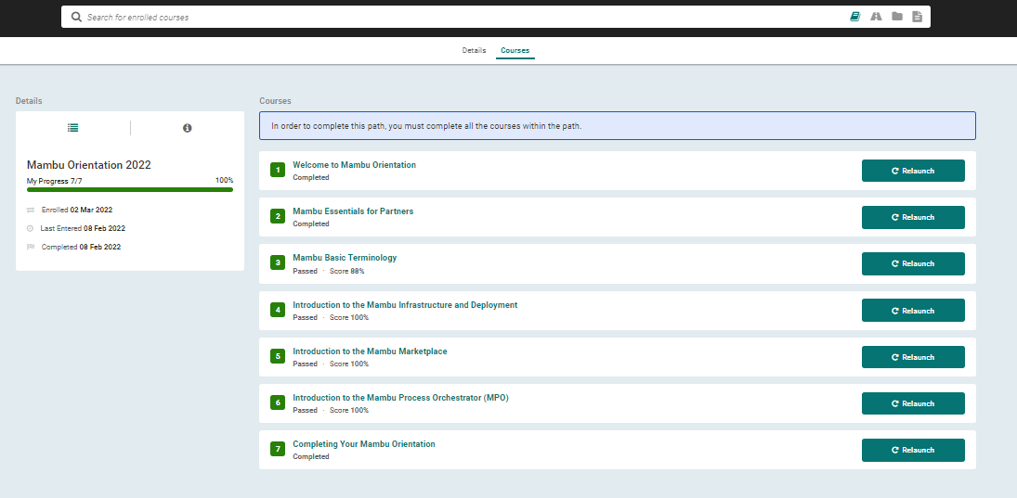
I. Mambu Partner Academy
Mambu Partner Academy: Learning Paths – Mambu Essentials for Partners
11. When to click the button Return dashboard is presented the menu with all courses. Click the course Mambu Essentials for Partners.
The details of course is updated
De status of the course frequented is updated for Completed
Click the course: Mambu Essentials for Partners

Slide 16
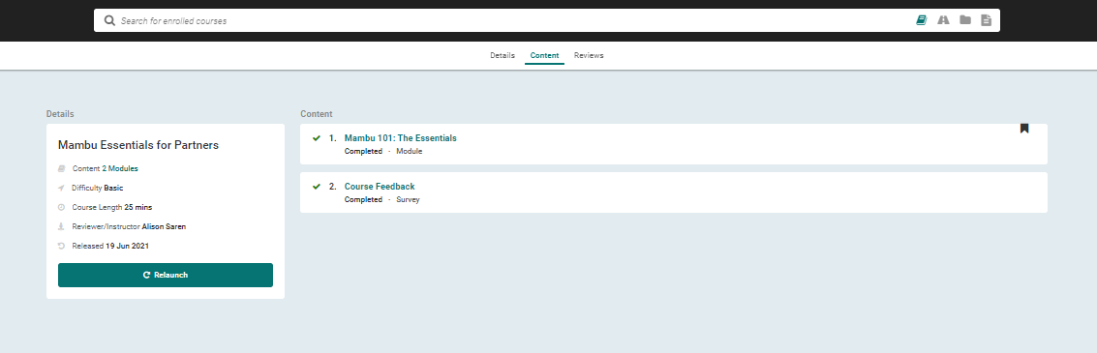
I. Mambu Partner Academy
Mambu Partner Academy: Learning Paths – Mambu Essentials for Partners
12. When launch the course, click the tab Content. In this view is presented all modules associated course frequented. Click the first module Mambu 101: The Essentials.
Note: At the end of each module, it is necessary to give feedback on the module, through a short survey.
Click the module Mambu 101: The Essentials
Details of course: Mambu Essentials for Partners
Survey: Course Feedback

Slide 17
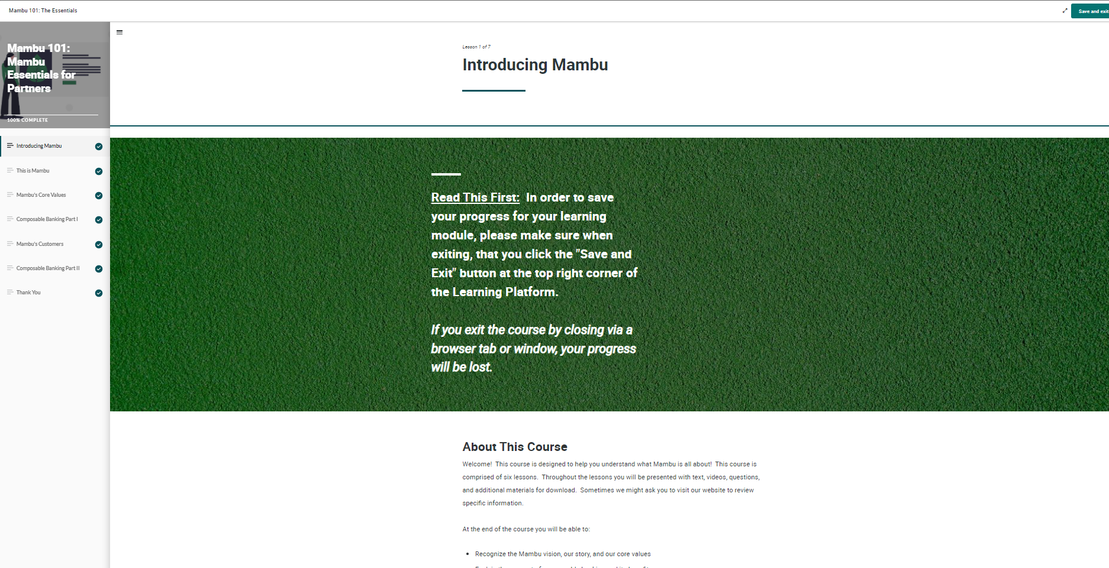
I. Mambu Partner Academy
Mambu Partner Academy: Learning Paths – Mambu Essentials for Partners
13. The module Mambu 101: The Essentials is make up per 7 lessons. Read all lessons with attention per order presented, and in the final of the all lessons click the button Save and exit, to return the previous menu.
Note: At the end of each lesson, it is necessary to answer a short quiz. To complete the session, it is necessary to have at least 75% in the quiz. The quiz can be answered multiple times.
Click: Save and exit
Lessons to make up the module
Lesson content

Slide 18
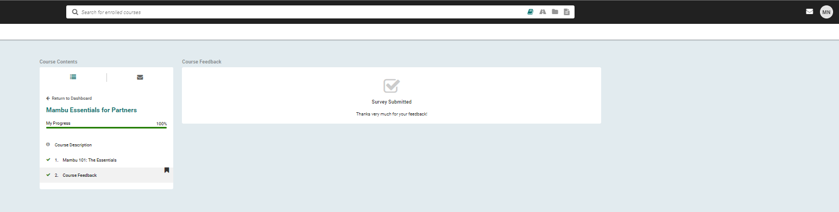
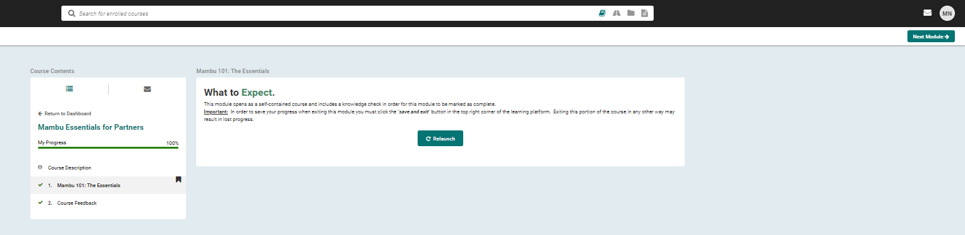
I. Mambu Partner Academy
Mambu Partner Academy: Learning Paths – Mambu Essentials for Partners
14. In the content of course, fill out the course feedback survey Course Feedback. And then click Next Module, to frequent all modules.
After submit the survey, appear a confirmation message
Click: Next Module
Note: Click the course Mambu 101: The Essentials to appear the button Next Module

Slide 19

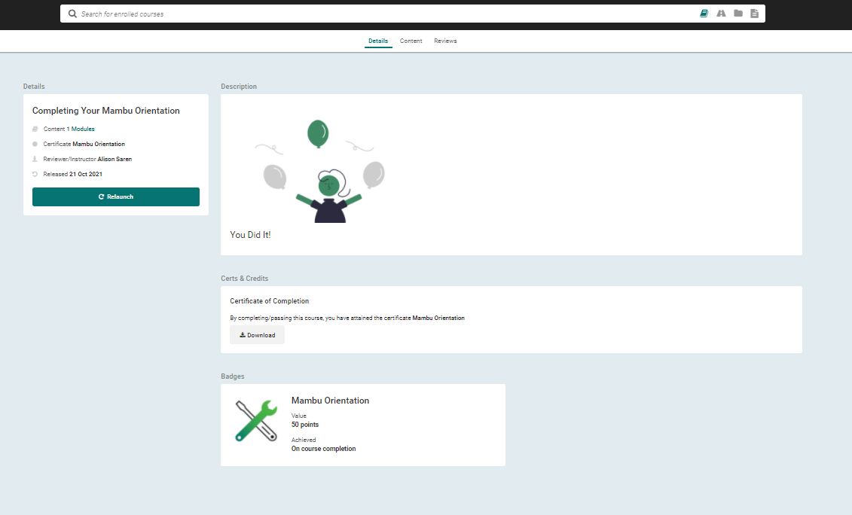
I. Mambu Partner Academy
Mambu Partner Academy: Learning Paths – Mambu Essentials for Partners
15. To complete the course, it is necessary to download the certificate at the end of each course. After downloading the certificate. The learning path progress bar will be full.
Click: Completing your Mambu Orientations
Click: Download

Slide 20
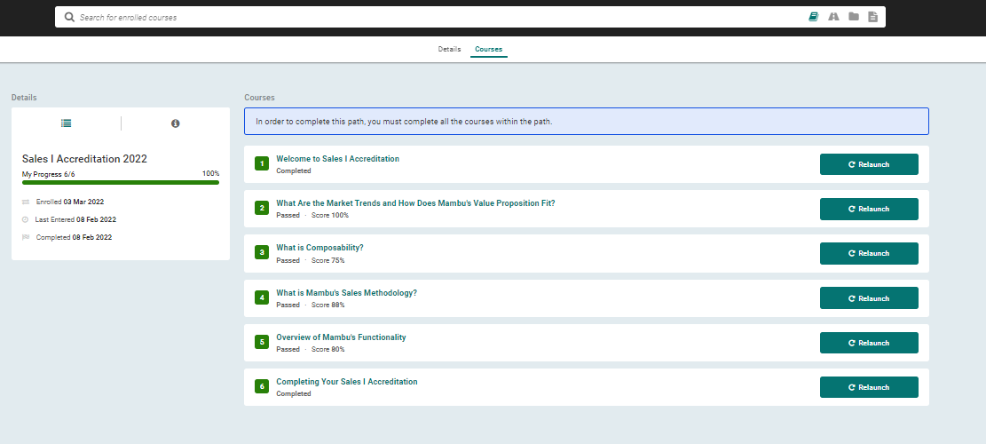
I. Mambu Partner Academy
Mambu Partner Academy: Learning Paths – Sales Accreditation
16. To complete the first learning path (Mambu Essentials for Partners), we proceed to the second learning path (Sales Accreditation). The tasks are the same, namely: attend the classes of each module, which make up the courses of the respective learning path.
Details of Sales Accreditation
Courses that make up a learning path

Slide 21
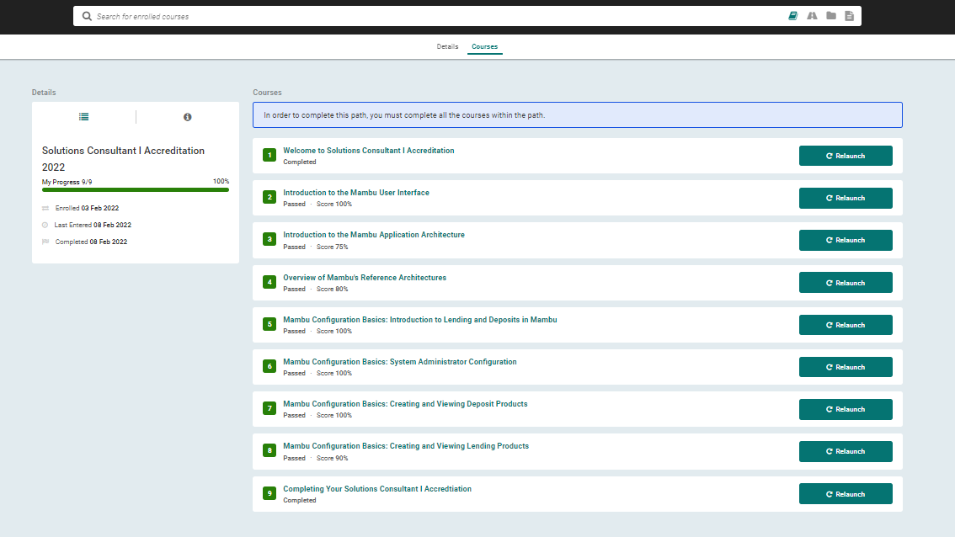
I. Mambu Partner Academy
Mambu Partner Academy: Learning Paths – Solutions Consultant Accreditation
17. To complete the second learning path (Sales Accreditation), we proceed to the third learning path (Solutions Consultant Accreditation). The tasks are the same, namely: attend the classes of each module, which make up the courses of the respective learning path.
Details of Sales Accreditation
Courses that make up a learning path

Slide 22
More Mambu
Useful Links
Sandbox: https://deloittept.sandbox.mambu.com/
Mambu Support: https://support.mambu.com/docs
Temporary Webhook: https://webhook.site/
Sandbox API Documentation: https://deloittept.sandbox.mambu.com/apidocs/
Mambu API Documentation: https://api.mambu.com/#welcome
Mambu Process Orchestrator: https://mpo-multitenant.mambuonline.com/
Mambu Community: https://community.mambu.com/

